Slide 1


Intelligent Parking Assistant
Presenter: Henry Huang
Team: IntelliPA
Hackathon FY20

Slide 2

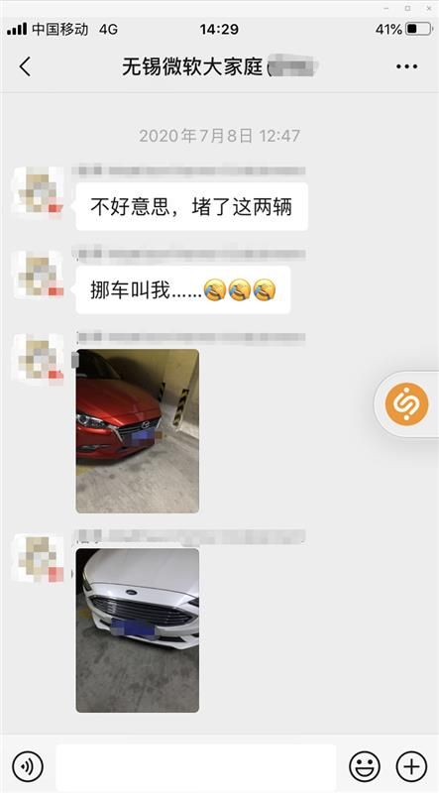
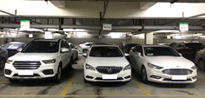
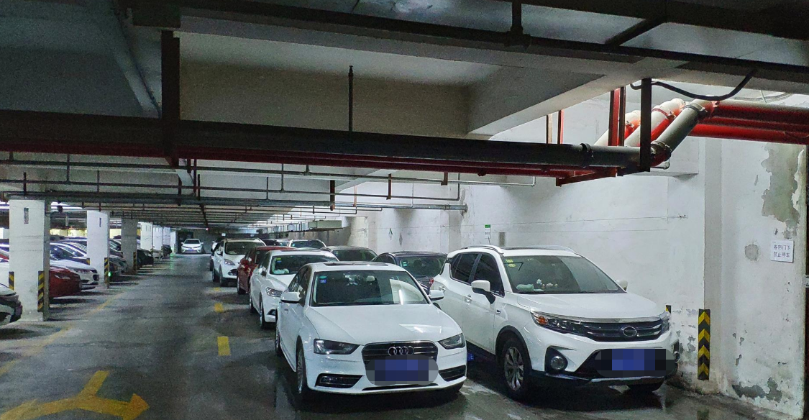
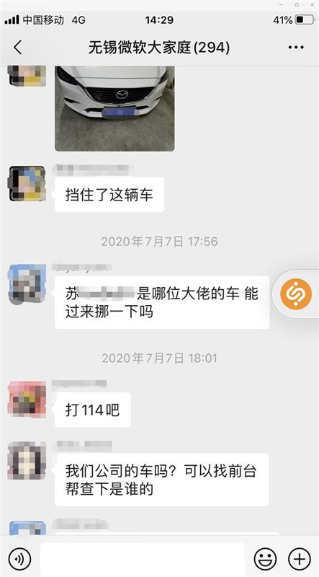
Issue & Potential Resolution
Limited Parking Spaces VS. Increasing Cars
Parking Bay cannot be easily re-constructed. Hence, we have Flexible Parking Bay
Also we need Intelligent Parking Assistant for more capacities and abilities.

Slide 3
Resolutions
Flexible Parking Spaces
IntelliPA, Parking Bay Managing Platform
Shared Car Park and more

Slide 4

Resolution - Flexible Parking Lots
Flexible Lots
Normal Lots
Indicating Line
Wall/Blocks
Head of Vehicle
Leaving Direction

Slide 5
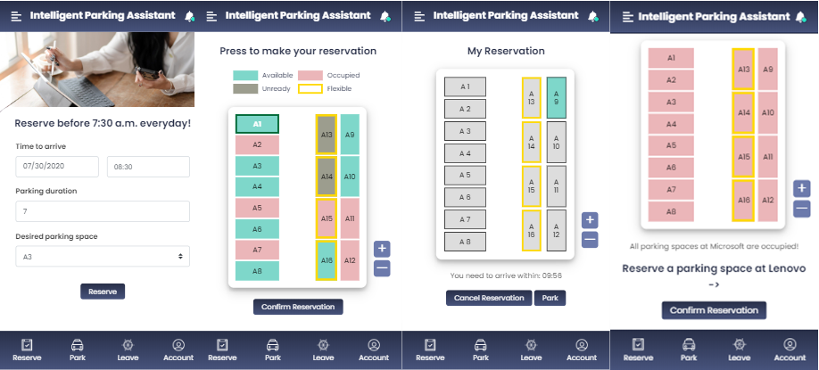
IntelliPA – Web/Mobile App
The Intelligent Parking Assistant app. (Front End)

Slide 6
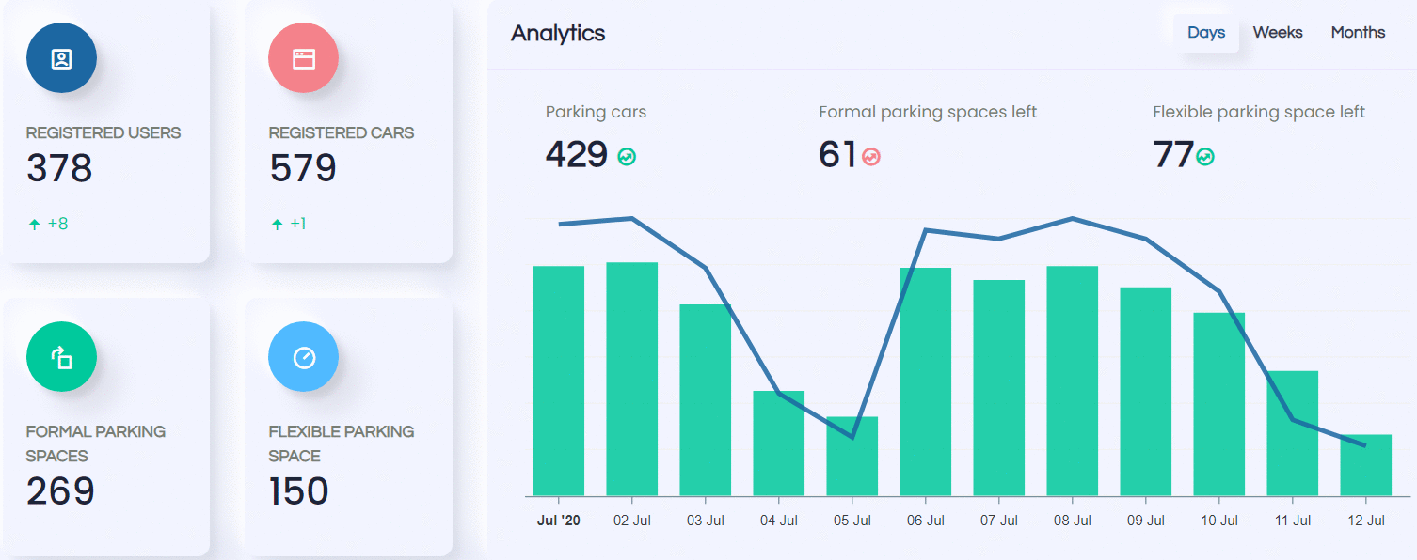
IntelliPA – Backend
Monitor
A monitor showing basic information of the selected estate.
Notes:
We developed a Back-End system for admin to see the real-time updated parking information, including remaining spaces, formal parking spaces left, flexible parking space left, remaining fixed parking spaces.

Slide 7

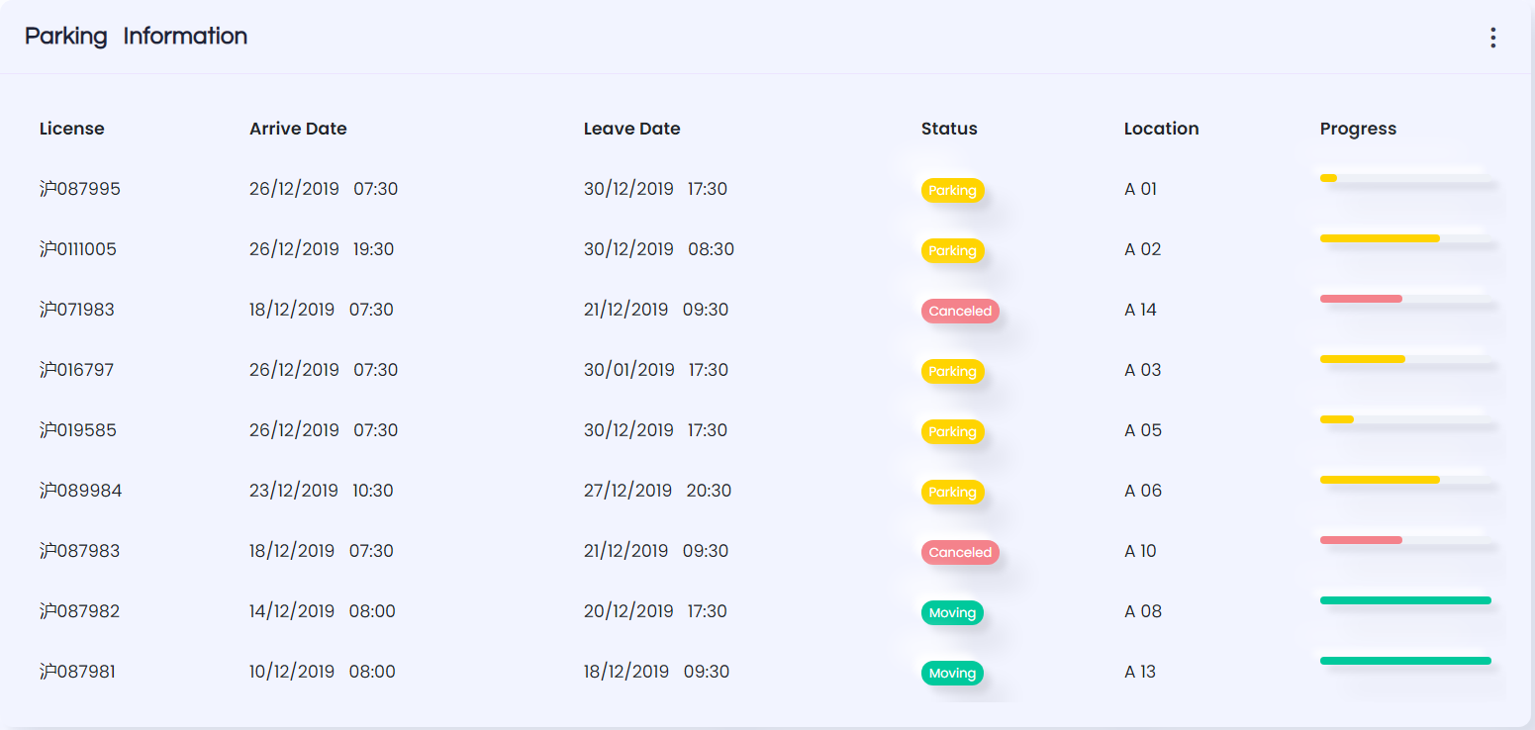
IntelliPA – Backend
Parking Logs
We also have a parking log section to show the status of each parking bay.
Current bay owner

Slide 8
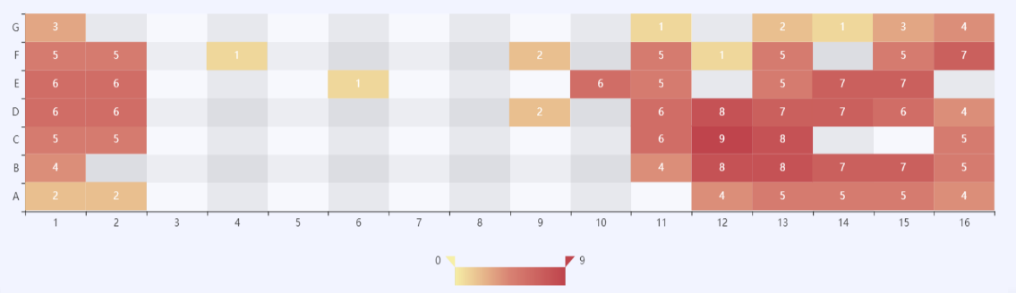
IntelliPA – Backend
Heat Map
Showing the occupied concentration of the Car Park.
Notes:
It can help the system monitor the parking flow in the area in real time, provide powerful help and support for precise command and dispatch, reasonable allocation of parking spaces, and scientific and efficient formulation of diversion strategies.

Slide 9




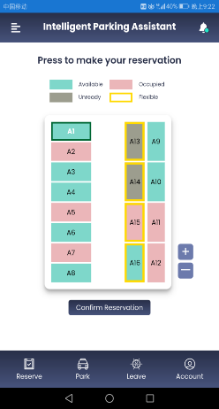











Intelligent Parking Assistant
Front End
APP
Interact with users
Azure
Xamarin
QRCode.js
Azure App
Service
Transform web app to client
QR Code Recognition
Static Web Apps
Azure Function
App
Empower performance
Distribute app to everyone
MyBatis
Back End
Database mapping
Azure
Spring
Powerful framework
Azure SQL
Azure Cache
Redis
NoSQL

Slide 10
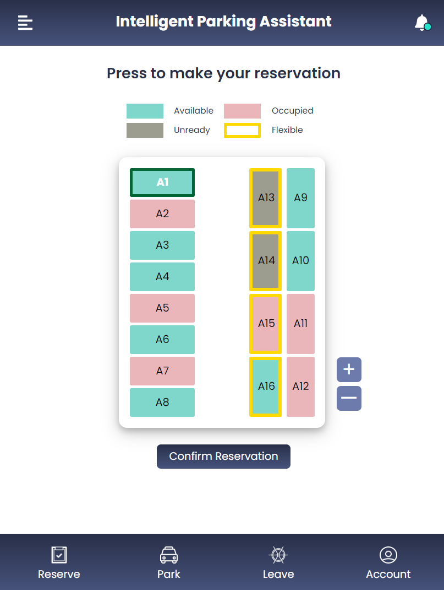
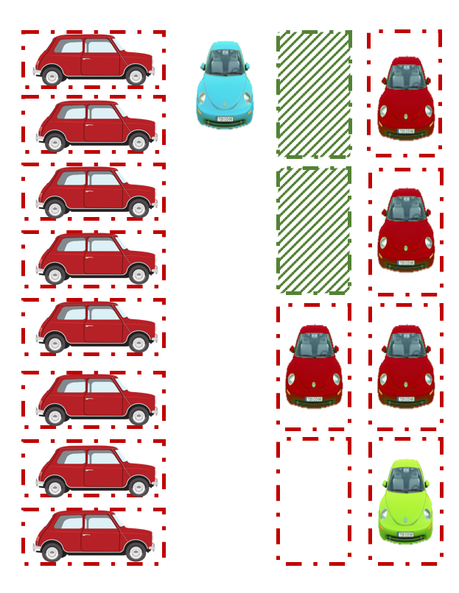
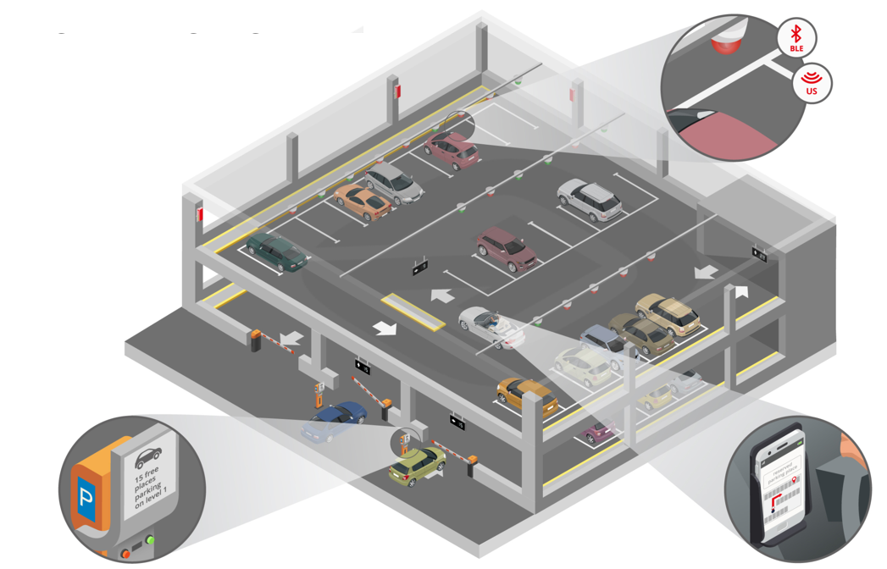
Core Advantages
Reservation & Parking Bay Navigation
Help users to find their pre-selected parking bays quickly
Flexible Parking Bay & Intelligent Management
Increase parking lot capacity without physical expansion by Flexible Parking Bay Algorithm
Shared Parking Spaces & Integrated Management
Fully utilize your/your company’s idle parking space resources and get rewarded!
Integrated Management system can help you manage all

Slide 11
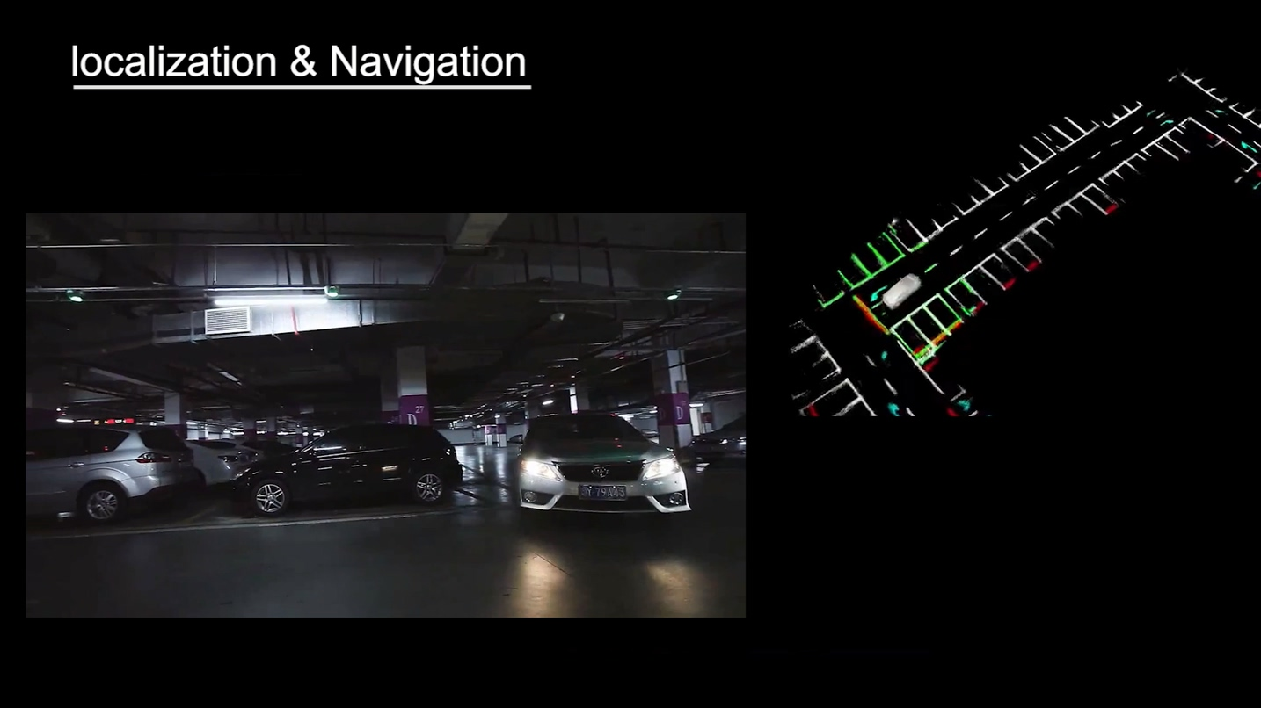
Future features & applications
1. Localization & navigation in parking space
It is easy for car drivers to lose their way when looking for their reserved parking space in large parking lot, and GPS signal cannot reach indoor parking lot, so the localization and navigation is difficult.
In the future we hope to include the novel localization technology like SLAM and realize the parking space navigation.

Slide 12
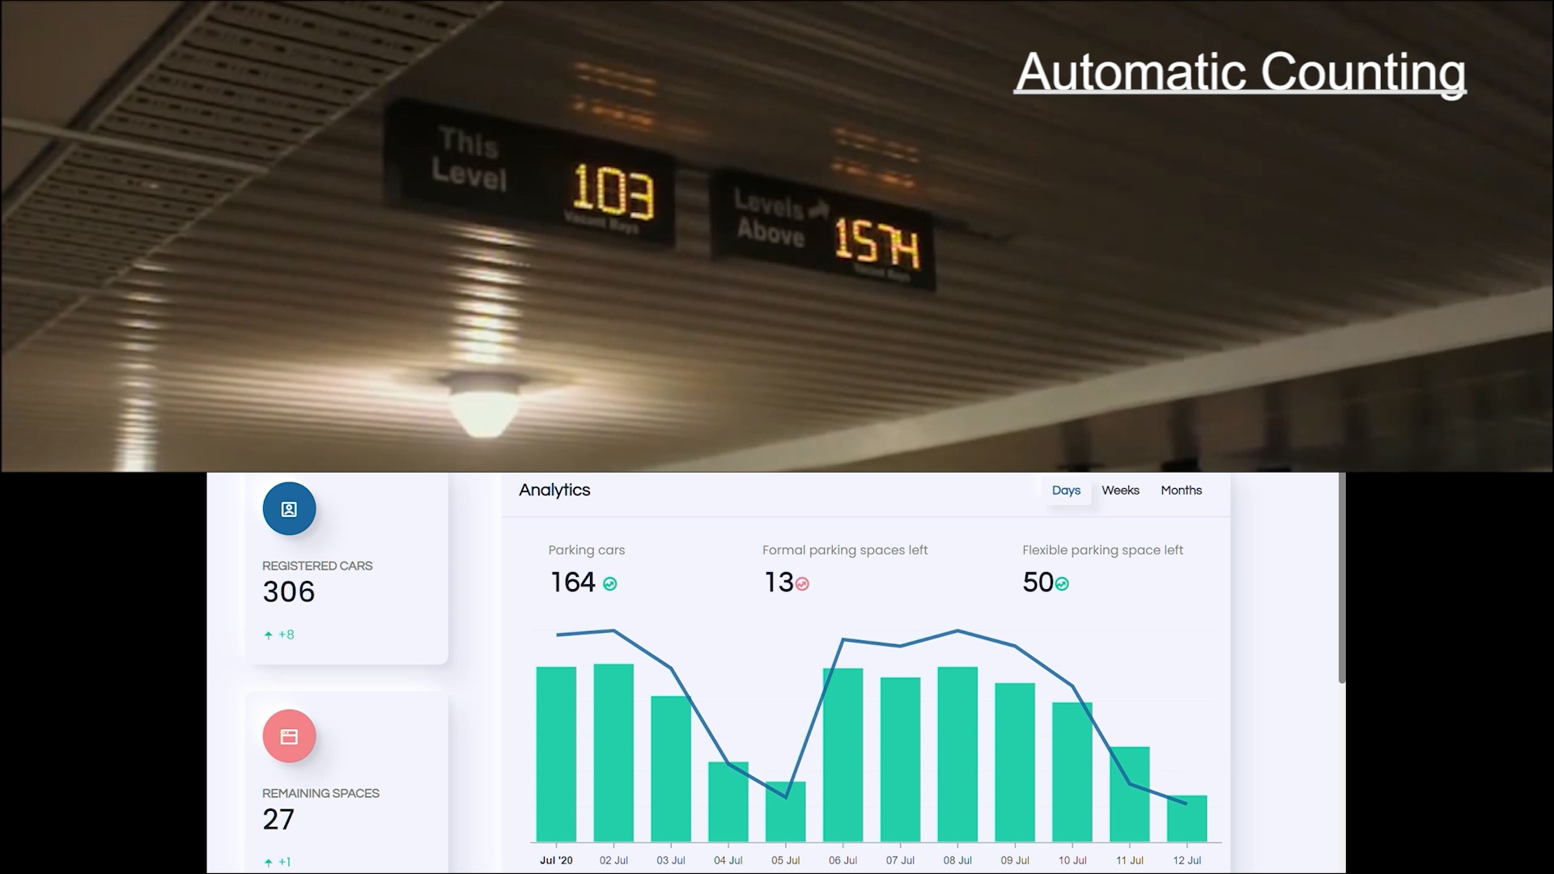
Future features & applications
2. Car automatic counting, parking recognition
In the future, we hope to link our application with the sensor in the parking lot, for example, using the detection sensor to realize the automatic counting in the entry and detect the parking car in each parking space, camera can also be used to recognize the license plate.
All this information can be uploaded to the back-end server and automatic update the relative data

Slide 13
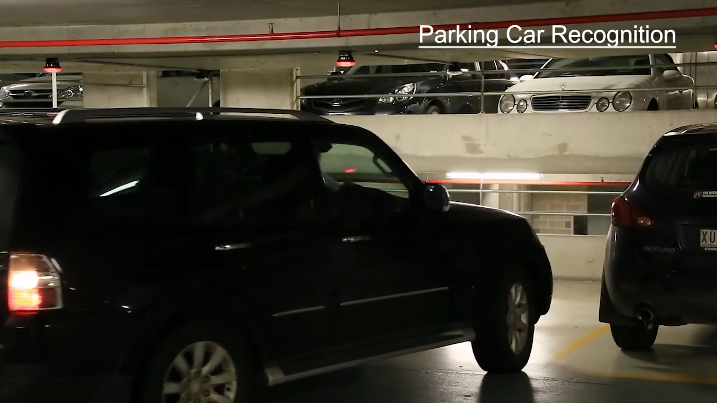
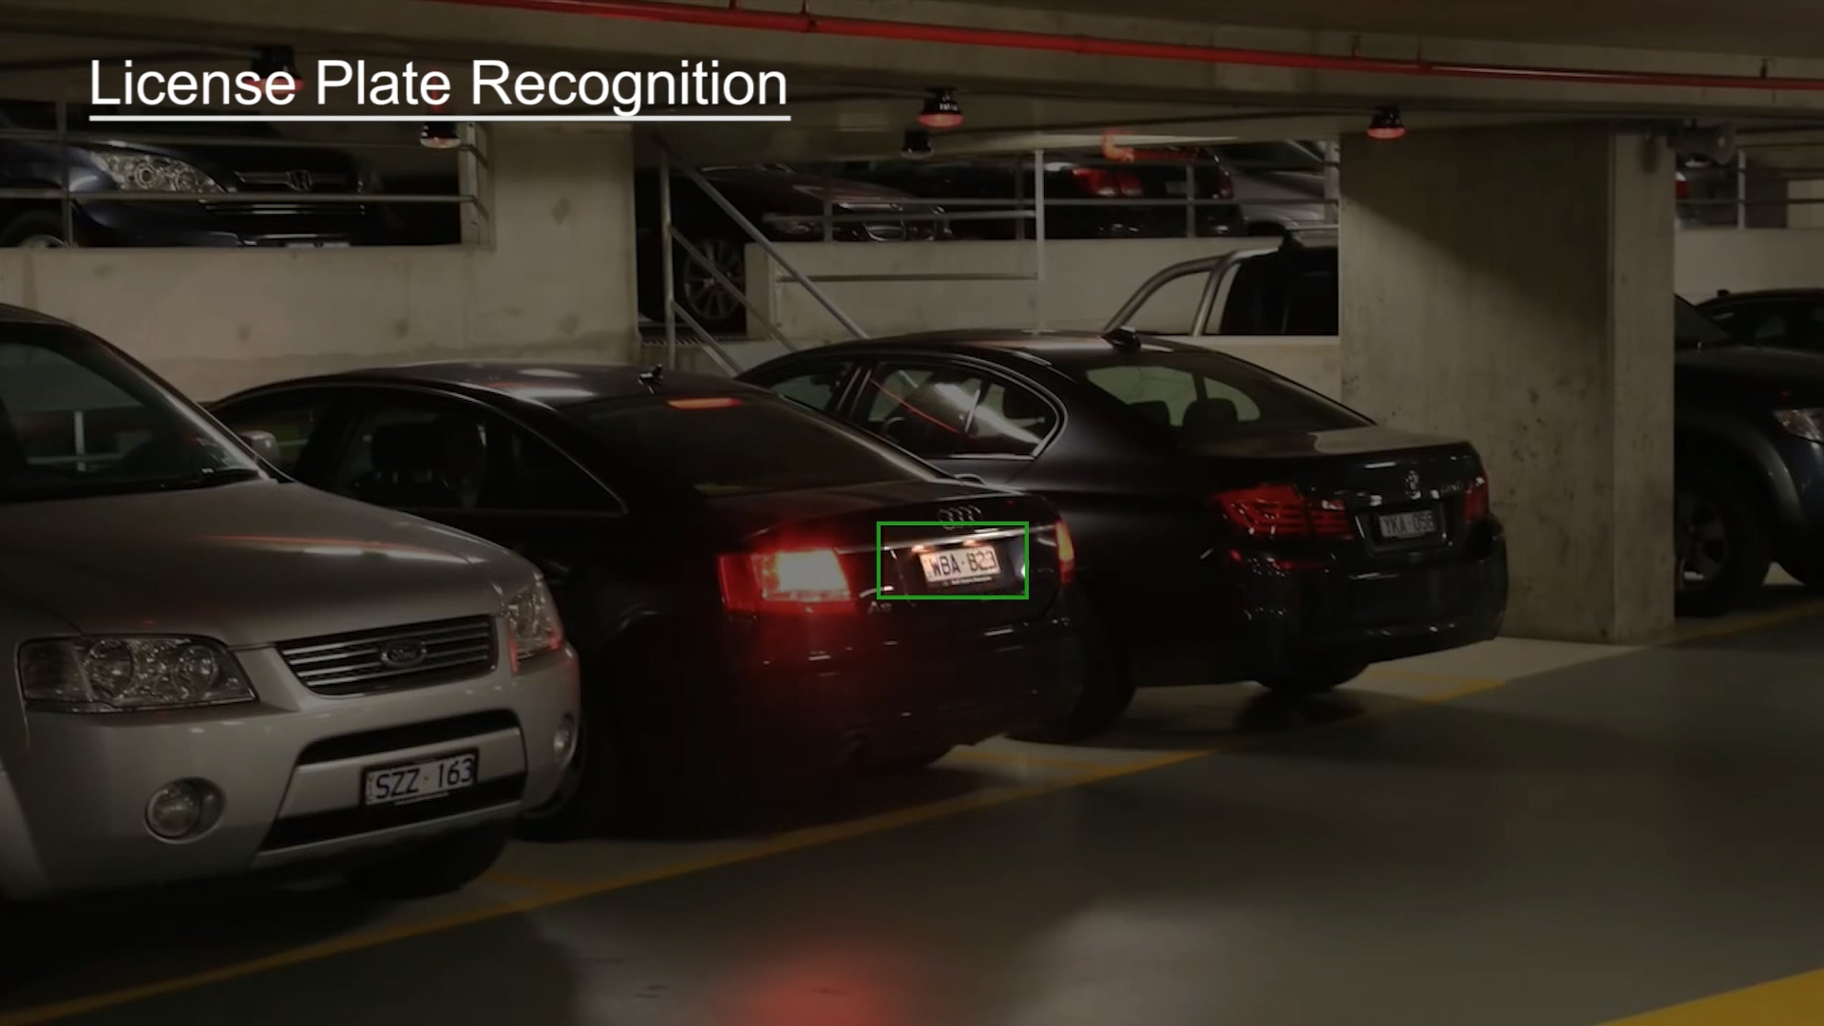
Future features & applications
2. Car automatic counting, parking recognition

Slide 14
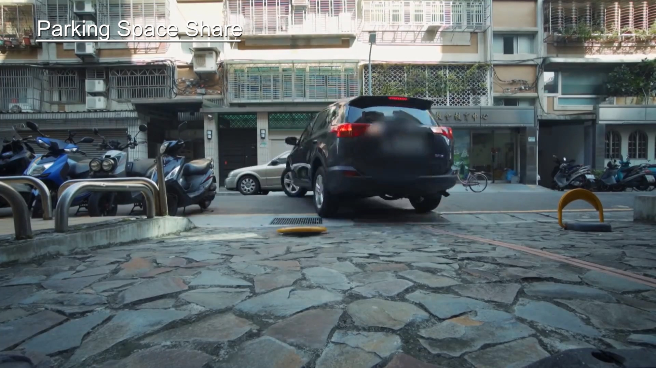
Future features & applications
3. Parking space locking & sharing
To avoid the reserved parking space or private parking space occupied by other cars, we can use the remote-controlled obstacle to lock the space.
If the private parking space is free, the car driver can even be shared, other car drivers can find out this shared parking space by mobile application

Slide 15









Meet our great TEAM!
Fan Xia
Aspire Program
Suyu Huang
Aspire Program
Zhengze Li
Aspire Program
Ziyao Hong
Aspire Program
Yonghui Feng
Aspire Program
Henry Huang
Support Engineer
Shuhao Yu
Support Engineer
Danwei Ruan
Support Engineer
Joe Wu
People Manager

Slide 16
Thank you!

